Slide 1
You Say You Want a Revolution:
A proposed model for training faculty on responding to student needs in times of political and community-based bias and violence
Erica Lennon, Psy.D.
Assistant Director of Clinical Services and Outreach
University of North Carolina at Charlotte
Notes:
Slide 6 & add last slide to have example of handout?

Slide 2
Faculty-Identified Barriers
Do not see it as a part of their role
“I believe that the university should host these discussions and faculty can announce them in the classroom. Courses should stay on topic. If the course topic is related to bias then a discussion is reasonable. Otherwise, it is not appropriate. ”

Slide 3
Faculty-Identified Barriers
Feeling unprepared to manage discussions and/or attend to needs
Worry about triggering students
“Checking in with a student who is already struggling may make it worse.”
“I don’t want to upset my students who aren’t thinking about it.”
Worry about triggering self
“As a Black man, there is no way I could have led my class in a discussion that next day cause I didn’t even know how to understand what I was feeling.”

Slide 4
Faculty-Identified Barriers
Worries about impact on professional standing and/or safety if broach topic
“I know folks are watching me and since I don’t have tenure yet I know it’s a reality that if they don’t like what they see I could lose my job.”
http://www.professorwatchlist.org/

Slide 5
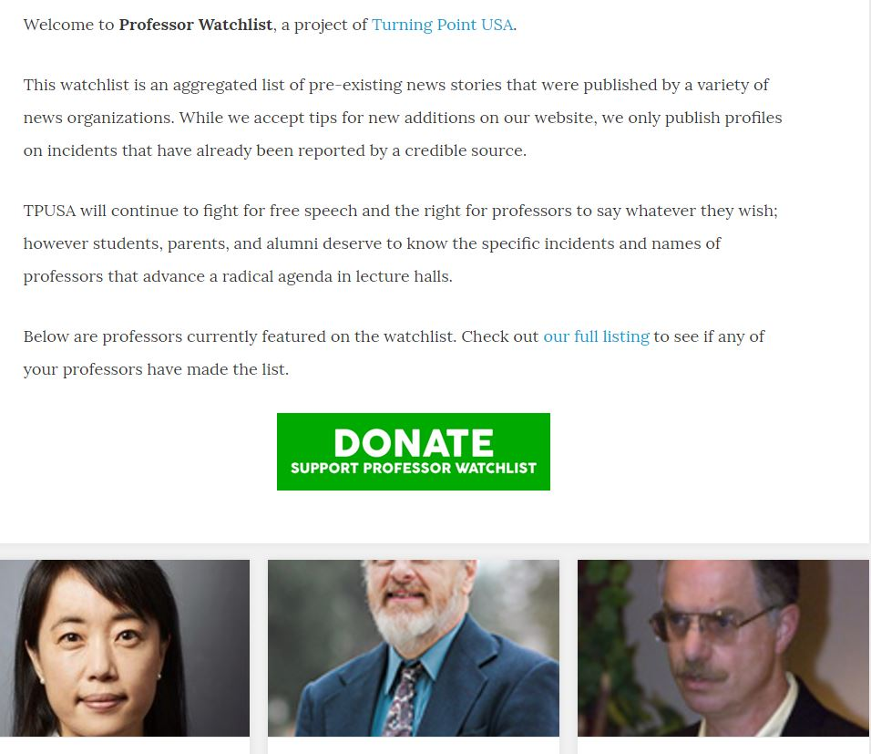
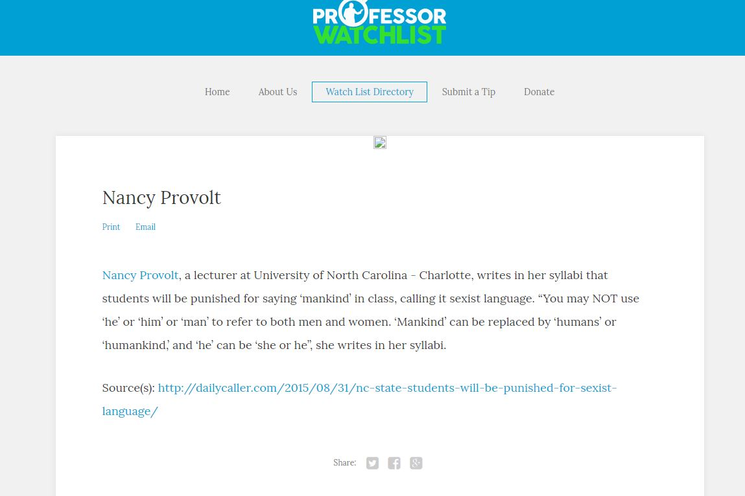

Slide 6
Laying the Foundation: Creating Partnerships
Top Down approach
Examine Counseling Center’s already existing relationships within Academic Affairs
Has Counseling Center done a previous training for academic affairs?
Grass Roots approach
Non-administrative faculty are indicating a need
Supporting faculty in banding together within a department or across departments to develop “proposed ask” to administration
Identify specific needs and how voids are impacting student classroom success (tie to College’s / Department’s goals)
Notes:
Top down approach: We had done suicide prevention work for Academic Affairs Colleges
Grass roots: Put faculty in touch with one another – kept list of faculty who called to schedule a consultation to identify departments/colleges represented and to link faculty to one another

Slide 7
Logistics of Training
90 minutes
Occurred during the annual retreat of Academic Affairs senior staff of our biggest college on campus
Dean, Associate Deans, and Department Chairs present
Prior to training met with Associate Dean on several occasions to plan
Solicit goals of college and connect to what Counseling Center can offer

Slide 8
Development & Implementation of Training
Part I: Psychoeducation
Faculty Barrier Addressed: Do not see it as a part of their role
Use “faculty” language
Connect mental health to performance in the classroom
Faculty’s desire to play integral role in expansion of student’s knowledge base
Faculty’s desire to have class grade showcase student’s grasp of the course information
Notes:
Expect varied beliefs about how knowledge of mental health and attitudes toward mental health

Slide 9
Development & Implementation of Training
Part II: Setting expectations (standardization)
Having discussion/dialogue or not
Explore how to handle consequences of each decision
Flexibility in expectations for students following critical incident (e.g. attendance/exams)
Notes:
Standardization is key – assist faculty administration in determining if each college, each dept, each professor will make a decision and how best to communicate this expectation; or will admin support individual professor decision
Consequences of each decision – if mandate professors do it: some professors will become upset saying it is not their role
- if require need to provide training for how to manage classroom discussions
If don’t require it some faculty may be upset about this indicating lack of support or interest for affected communities
- usually can get more buy in in asking professors to allow flexibility as needed – if test or assignment scheduled that day can it be delayed? Can students opt into test on another day or have a couple days extension for assignment

Slide 10
Development & Implementation of Training
Part Three: Faculty Tools
Acknowledging critical incident
Introducing discussion & setting group agreements
Managing differing points of view
Education regarding consultative role of Counseling Center
Factors in individually monitoring students
Warning signs
Kognito – At Risk online simulation
Notes:
Tools for creating healthy classroom dialogues and how to check in directly with students (what are warning signs?)
Setting group agreements – permission to leave as needed
Even if decided will not have discussion – acknowledgment is key
- provide lang examples and recommend faculty acknowledge that there is likely a range of emotions students are experiencing; could invite students to let faculty know of any concerns related to class
Explicit permission to leave classroom and not be verbally or physically present in discussion is key

Slide 11
Follow Up
Evaluation of training (formal vs. informal)
Development of handout for faculty to increase accessibility of information
Developed in collaboration with Multicultural Academic Services, Dean of Students, and Multicultural Resource Center
Solicited feedback from faculty at a couple of points in development
Utilize connection with one college to open doors for other colleges

